Slide 1
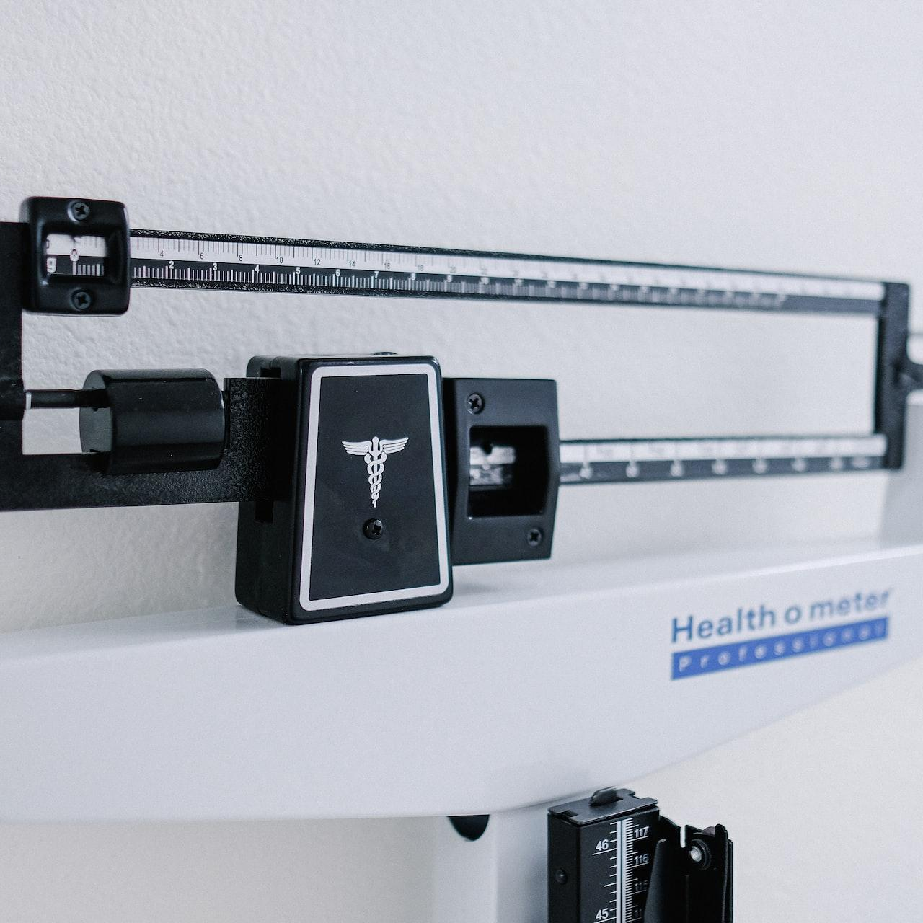
Day 4:
Better BMI
Introduction
Notes:
Photo by Kenny Eliason on Unsplash

Slide 2

Your 6-Day Success Plan
You have done this!
Day 0 (30 mins):
Roadmap to Software Dev
Learn the pros of being software dev
Learn the step by step to be software dev

Slide 3
Your 6-Day Success Plan
You also have done this!
Day 1 (1h):
Learn creating a website using HTML
Create Your First Website
Understand how websites understand HTML
Use HTML to create links & texts
Build a resume website

Slide 4
Your 6-Day Success Plan
You also have done done this!
Day 2 (1h):
Learn to style a website using CSS
Styling Websites
Add your profile picture for employers!
Learn to create buttons and design them
Build a Link in Bio project

Slide 5
Your 6-Day Success Plan
You also have done done done this!
Day 3 (1h):
Learn data types such as numbers & strings
Build Interactive Website
Understand how to store data in variables
Learn how to show data
Create BMI calculator

Slide 6

Your 6-Day Success Plan
We are currently here
Day 4 (1h):
Learn to get user inputs
Better BMI
Understand how to make website interactive
Create better BMI calculator

Slide 7
Your 6-Day Success Plan
Day 5 (1h):
Learn how to create a list of quotes
Random Quote Generator
Show the quotes randomly
Create random quote generator

Slide 8
Your 6-Day Success Plan
Day 6 (1h):
Learn how to know if answer is correct
Quiz App
Show if the user got it right or not
Create quiz app

Slide 9
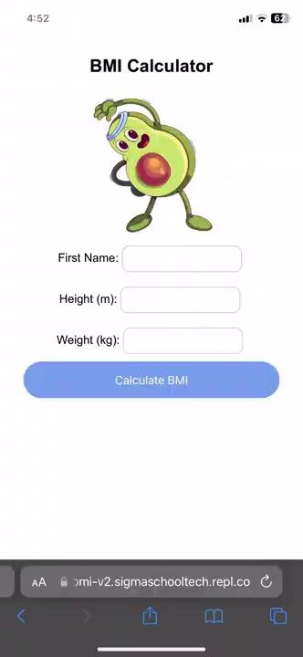
What you are building
A version 2 bmi calculator that has text inputs for user to key in their weight and height, shows up their BMI result!
What you are learning:
- Learn to add text inputs
- Understand how to use the DOM to control the website logic
- Create better BMI calculator
Demo project here.

Slide 10
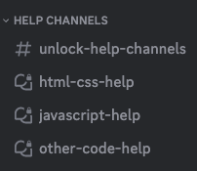
Need help?
We are happy to help with any issues, things you don’t understand in our Discord channel here.
Here is our full link:
https://discord.gg/yCrB7tfbhg
Once in discord, add your questions in our help channels.

Slide 11
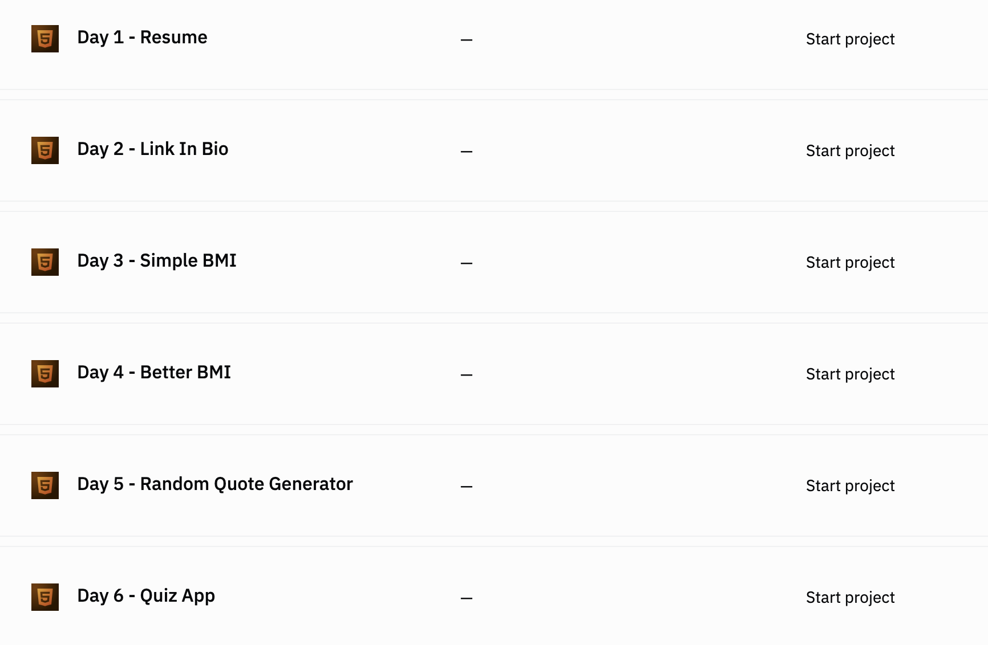

Go to our team dashboard: https://sig1.co/replit-6in6
You can click on Day 4 - Better BMI

Slide 12
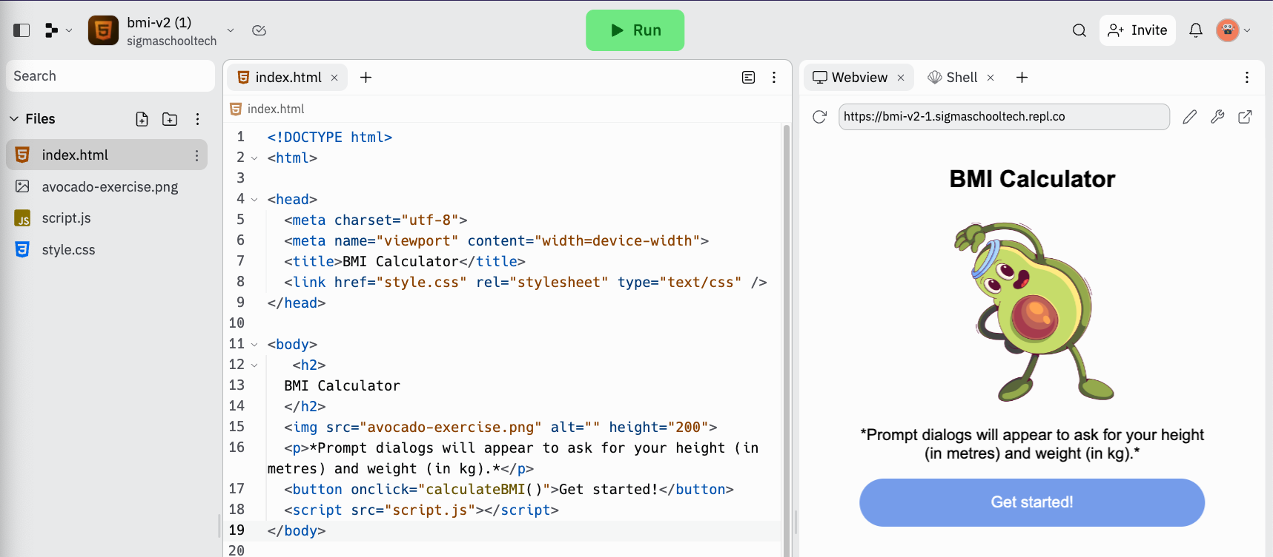
It will bring you to a new replit page.

Slide 13
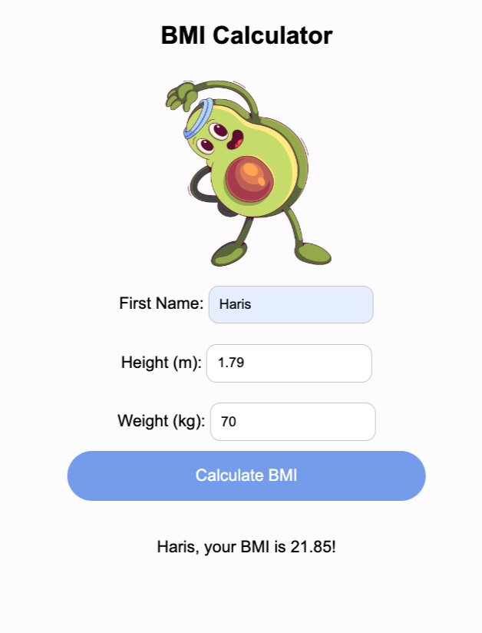
Let’s breakdown the design
Form
Text inputs
We have labels, which are text that are placed beside the text inputs.
We also have a paragraph that shows what your BMI is.
However, for labels and text inputs, they need to be in a container called a form.
Form is a way to collect information.
Let’s update the code to make it look like the design!
Labels
Paragraph

Slide 14
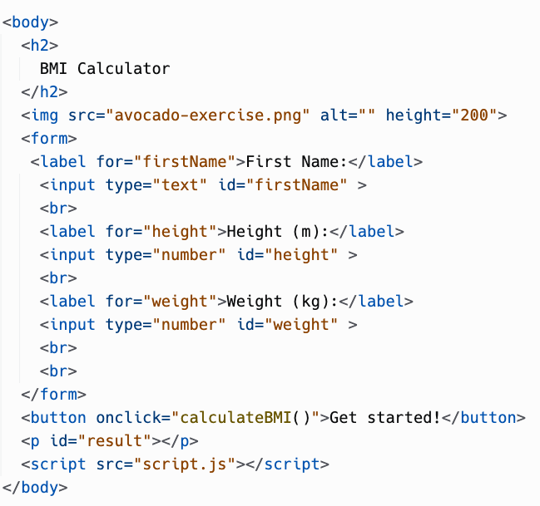
In index.html, update the code to this.

Slide 15
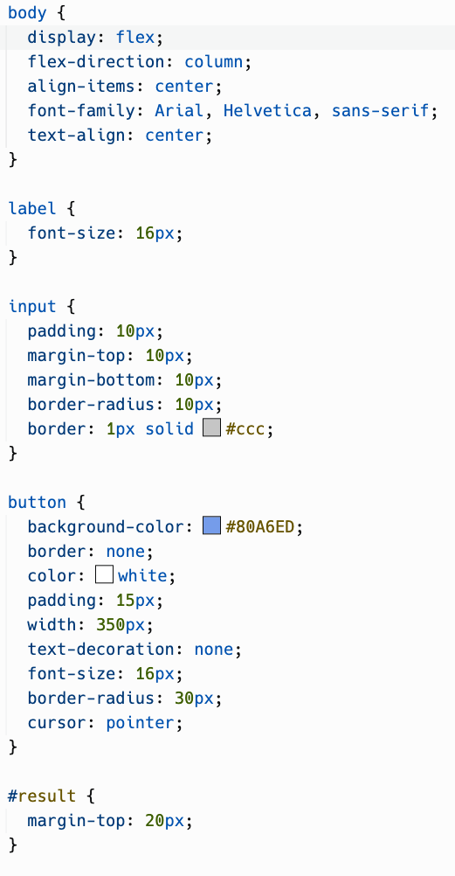
In the style.css, update the code as well.

Slide 16
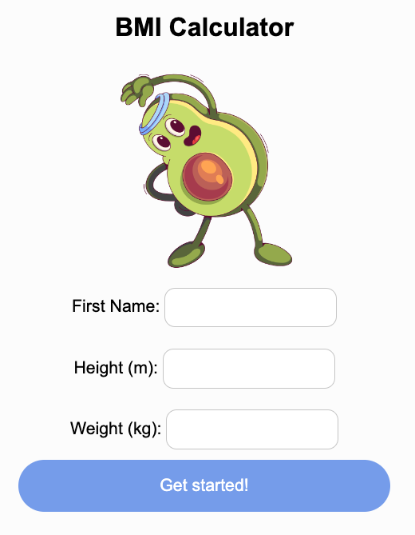
Run the code. It should look like this.
Let’s break it down

Slide 17
<form>
The form is a way to show the start and end of the form.
Usually, we put in label and inputs.

Slide 18
<label>
The label is usually paired with an input element.
The for attribute, with value firstName is usually the same with the input id firstName as well.

Slide 19
<label> purpose
This allows screen readers and other assistive technologies to know what the label is for and makes the form more accessible for users who may not be able to see the form.

Slide 20
<input>
It is a text box for users to add their input.
The type attribute of the <input> tag is set to "text" to create a simple text box.
The id attribute is used to identify the input field for styling or JavaScript purposes.
Later we will go dive deep on the id attribute. What about number input?

Slide 21
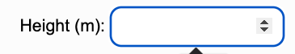
<input type=”number”>
This basically filters your input to take in only numbers

Slide 22
<br>
Short for break.
I definitely need one.
Anyway, it adds a line break or a blank line into the text of a web page.
Here is an example without a break.

Slide 23
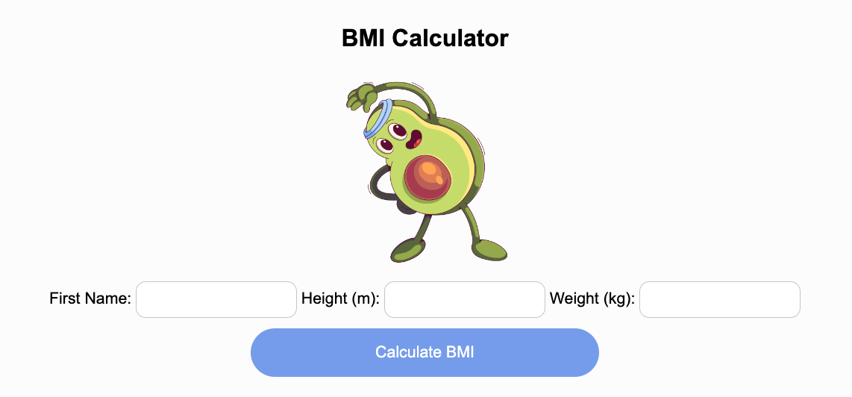
Without break

Slide 24
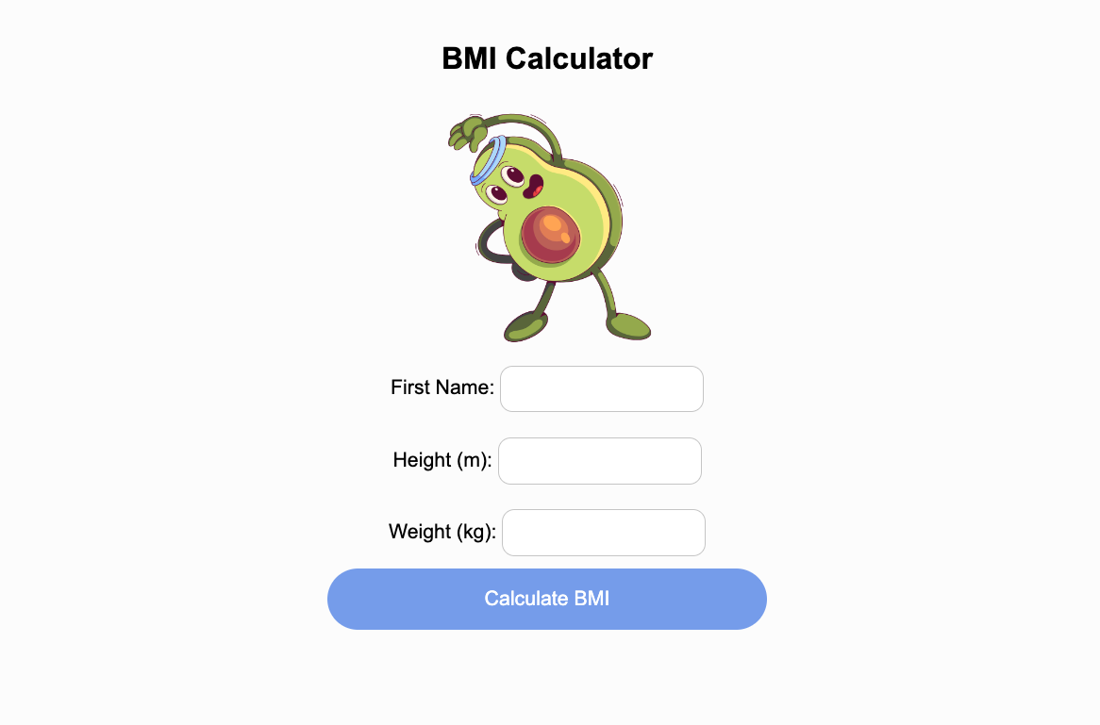
With break

Slide 25
Now, let’s explain the css part.

Slide 26
font-size
Controls the size of your text

Slide 27
margin
Adds space outside of your element

Slide 28
#result
Nope, it’s not for social media.
It is to refer to a specific element id.
And id is usually to differentiate from one element to another.
Therefore, to style an paragraph with id result, you use # in CSS

Slide 29
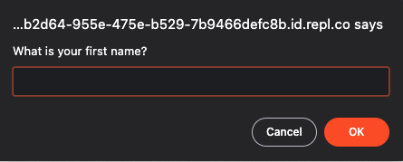
We are still showing dialogs when we click on the button, let’s change it!

Slide 30
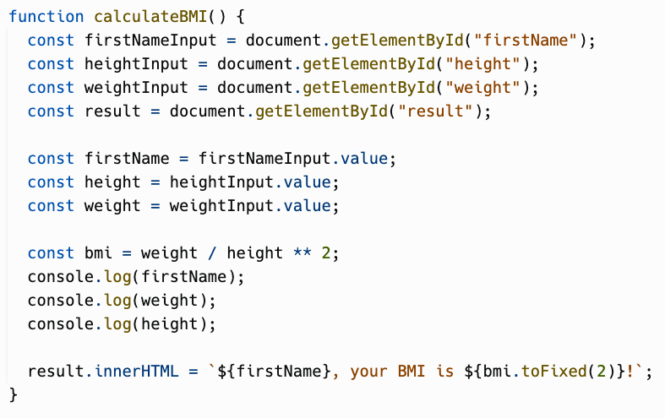
In script.js, update your code and run it!

Slide 31
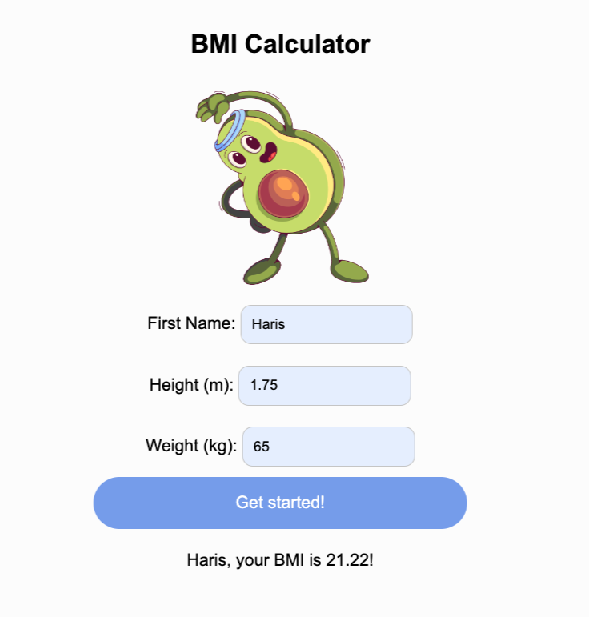
Test the web application, and it should look like this.
Let’s break it down.
1
2
3
4
5

Slide 32

Document
Object
Model
Introduction
Notes:
Photo by Beatriz Pérez Moya on Unsplash

Slide 33
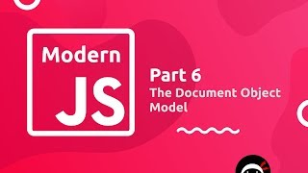
Document Object Model Explained

Slide 34
document in DOM
We refer to the whole of the website as a document.
And the document has different functions
One of them is document.getElementById(“firstName”)
This will return us an element with an id attribute firstName.
With this element we can…

Slide 35
Value from input
To get the value from the firstName element, we need to get its value.
Which is now Haris.

Slide 36
Same goes for the rest

Slide 37
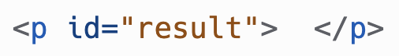
paragraph
When we call the line of code above, we are essentially returning this:
When we write this: We are referring to this.
Right now, the result.innerHTML is “ ”, which represent an empty space.
Using DOM, we can set this.

Slide 38
Set innerHTML
We can set the innerHTML just like a variable.
We are setting to a string. However, this is another type of string. The string below is called template literal.
Let’s go through step by step.

Slide 39
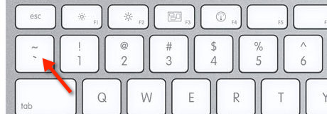
Template Literal
First, it uses backticks. Not ticks ✅ Or ticks 🐜
This tells Javascript it is a template literal string. Next up…

Slide 40
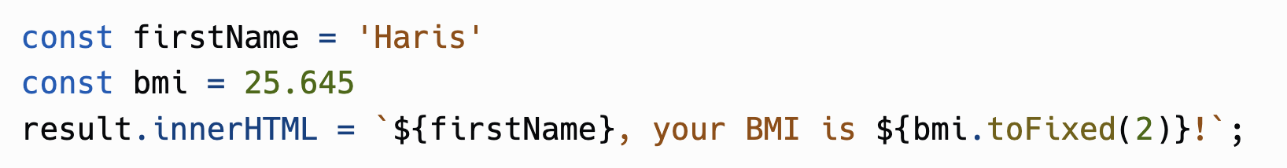
Place holders
The ${} are placeholders. They will get replaced with the actual values. For example:
This will end up to be:

Slide 41
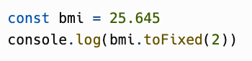
.toFixed(2)
This rounds up a number or variable with number value, to the nearest decimal or fixed place. Since it is .toFixed(2), we are rounding up to the nearest 2 decimal place:
This will be logged in the console as:
25.65

Slide 42

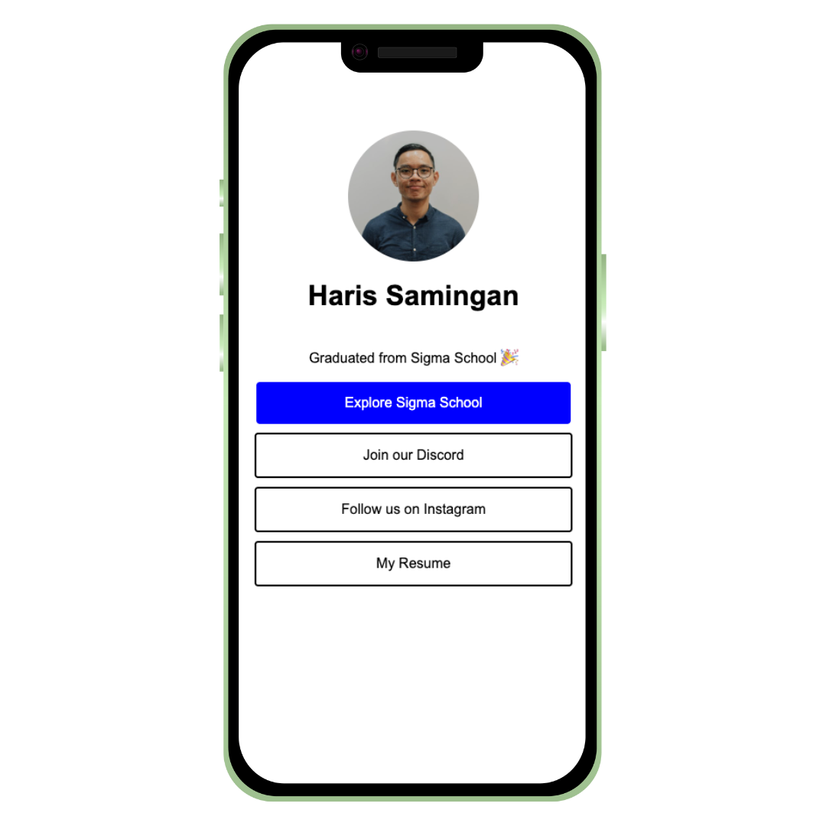
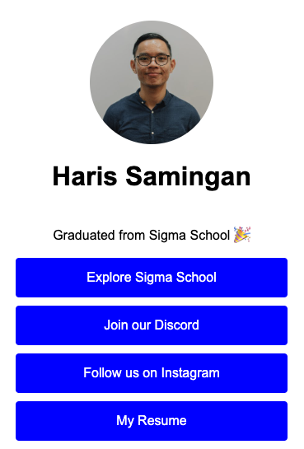
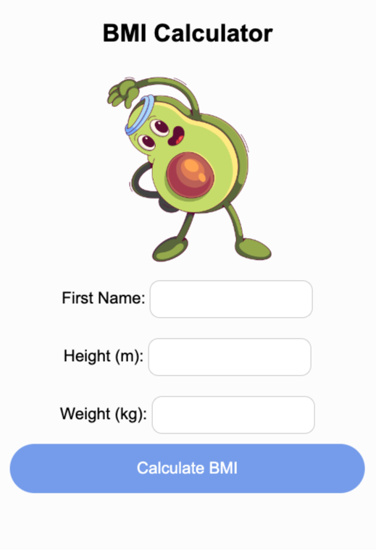
Congratulations!
You have created a web application!
Share it in our Discord channel here.
More specifically under the Share Your Achievements section > #i-built-this channel.

Slide 43
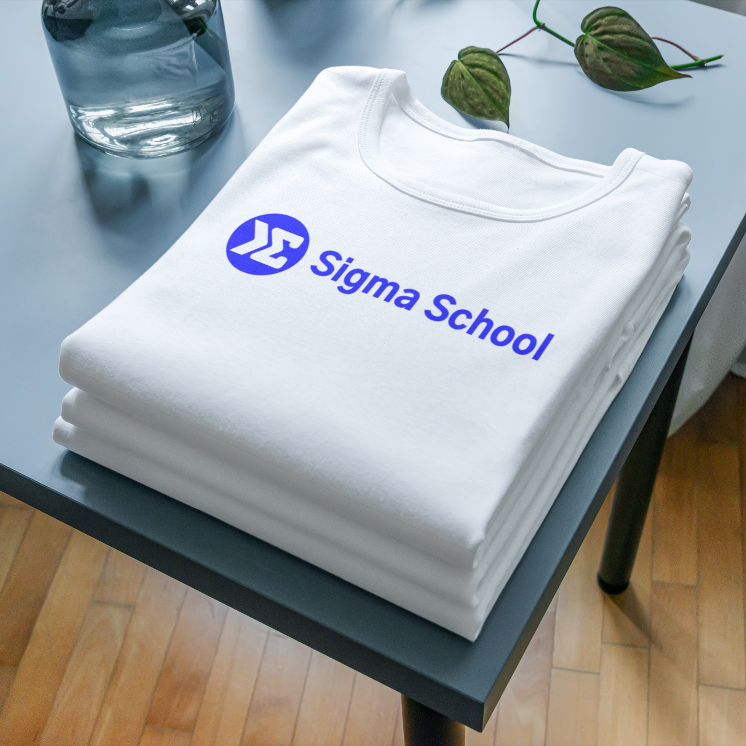
Good work. Now, gain points!
Now that you have completed this module, you can gain points by doing this survey:
https://forms.gle/FJzRxgVw7fS2DMPY9
You can gain up to 16 points!
Currently, you can get a free Sigma T-shirt for 150 points.
There will be more freebies in the future ~
Not real. Picture is for illustration purposes.

Slide 44
Full code here:
https://replit.com/@sigmaschooltech/bmi-v2

Slide 45
Day 4 completed!

